Slide 1


Week 3
1

Slide 2
Index
2
Sr no | index
1 | Week3Sketch1
2 | Week3Sketch2
Sr. no
1
2
3
4
5
Contents
Week1Sketch1
Week1Sketch2 Week1Assignment1
Week1Assignment2 Insights

Slide 3
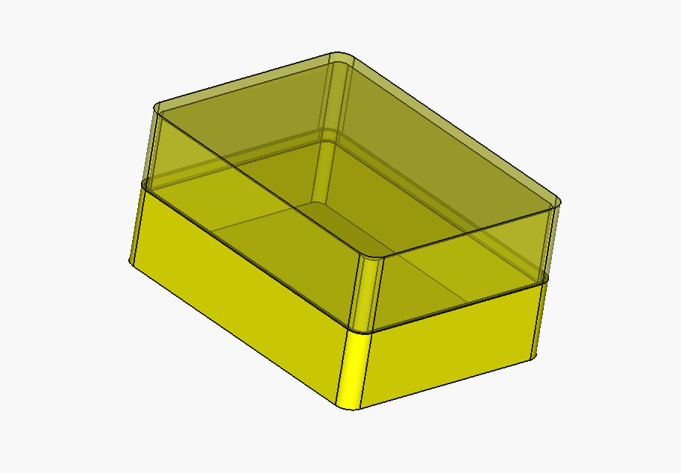
Week3Sketch1

Slide 4
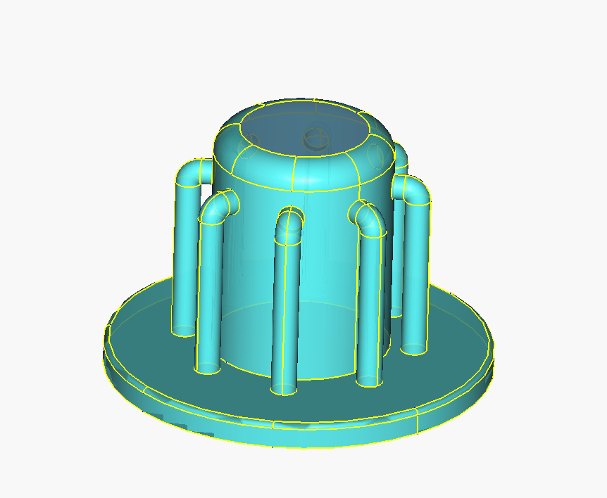
Week3Sketch2

Slide 5
Insights
Learn about shape blinder
Learn about refernce geometry
Thinking about tolerances (preesfit)
Learn about additive pipe tool
Learn how to do task in more simple way

